Slide 1



Project Title: Book Library
KONGU ENGINEERING COLLEGE
PERUNDURAI ERODE-638060
Department of Computer Science and Design
22VP003-MINI PROJECT
PRESENTED BY :
Raghav MK (22CDR076)
Siva Kavindra T (22CDR096)
Sriram R (22CDR100)
BATCH NO: B20
PROJECT GUIDE: Dr.P.Jayanthi

Slide 2
INTRODUCTION - PROBLEM STATEMENT
BOOK LIBRARY
Develop a simple book library application where users can keep track
of their personal book collections. Include features like adding books, categorising
them, and displaying book details.

Slide 3
PROJECT CONTEXT
Aiming to address the need for a user-friendly platform for managing personal book collections, fostering
reading habits, and enhancing the reading experience.
Current applications lack comprehensive features for tracking reading progress, categorizing books, and providing personalized recommendations, resulting in limited user engagement.
SCOPE:
Develop a Progressive Web Application (PWA) that allows users to manage their book collections, track reading progress, receive notifications in email.
OBJECTIVES:
Provide an intuitive interface for adding, updating, and deleting book entries.
Implement real-time notifications for users on reading updates.
Incorporate data analytics for insights into user behavior and app performance.
Foster community engagement.

Slide 4
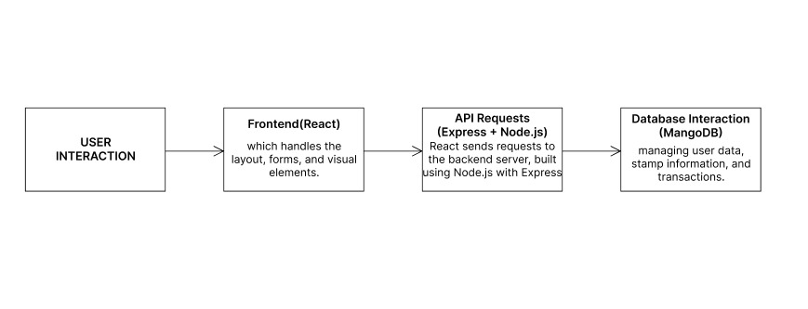
DATA FLOW DIAGRAM/ ARCHITECTURAL DIAGRAM/ FLOW CHART/ STATE FLOW DIAGRAM

Slide 5
SOFTWARE REQUIREMENT SPECIFICATION
FRONT END: REACT JS
React JS is preferred to handle the rendering problem.
It update and renders only the necessary components which helps in smooth interaction.
BACK END: (Express + Node JS)
React sends the requests to the backend server which is build using the Node.js .
The information passed such as adding the data or deleting the data or updating the data are handled by separate API request and response.
DATABASE: Mongo DB
It is used for managing user data, book information.
The book and user data are stored in different schema.

Slide 6
MODULE SPECIFICATION
User Authentication
Book Display and Search and Filter
Requirement form
Add Book after verification
Reading Progress Tracking
Notification
Analysis and Insights

Slide 7
TECHNICAL IMPLEMENTATION / FEATURES
INITIAL SETUP
Set up Node.js and MongoDB locally, using Visual Studio Code for development.
Implement React.js for building user interface.
Use Express.js for server-side application development and MongoDB for data storage, utilizing Mongoose for database interaction.
FOUNDATIONAL WORK COMPLETED :
Connection of frontend, backend and database.
Development of sign up,login,home and other pages with logic and Database collection creation.
Analyze user behavior and application performance using data analytics tools(Pie Chart) to drive informed improvements and displayed in the dashboard has been implemented.
CRUD operations to allow users to create, read, update, and delete their book entries.
Completion of web page with two authentication.
DIFFICULTIES FACED :
Implementing the logic for each page creation in the website.

Slide 8
FUTURE PLAN
Improve the CSS and creation other simple pages such as about us, contact information etc.
Add the journals dataset to database.

Slide 9
CONCLUSION
CURRENT PROGRESS
Integration of frontend(React JS) ,backend and Database have been done
Two collections for this web app user and book have been updated and data has been uploaded.
Email will be sent if the new user done the signup.
Search menu option and other filters for the books have been implemented.
Various pages such as login,signup,home,favorites,book pages have been created.
CRUD operations have been implemented.
Completion of web page with two authentication.
IMPACT OF THE PROJECT
It helps in motivation of the readers as the person who have the read the most number of books by providing the points.
Data visualisation and analysis for the project.
The verification will be done by server side person(librarian).

Slide 10


